Slide 1

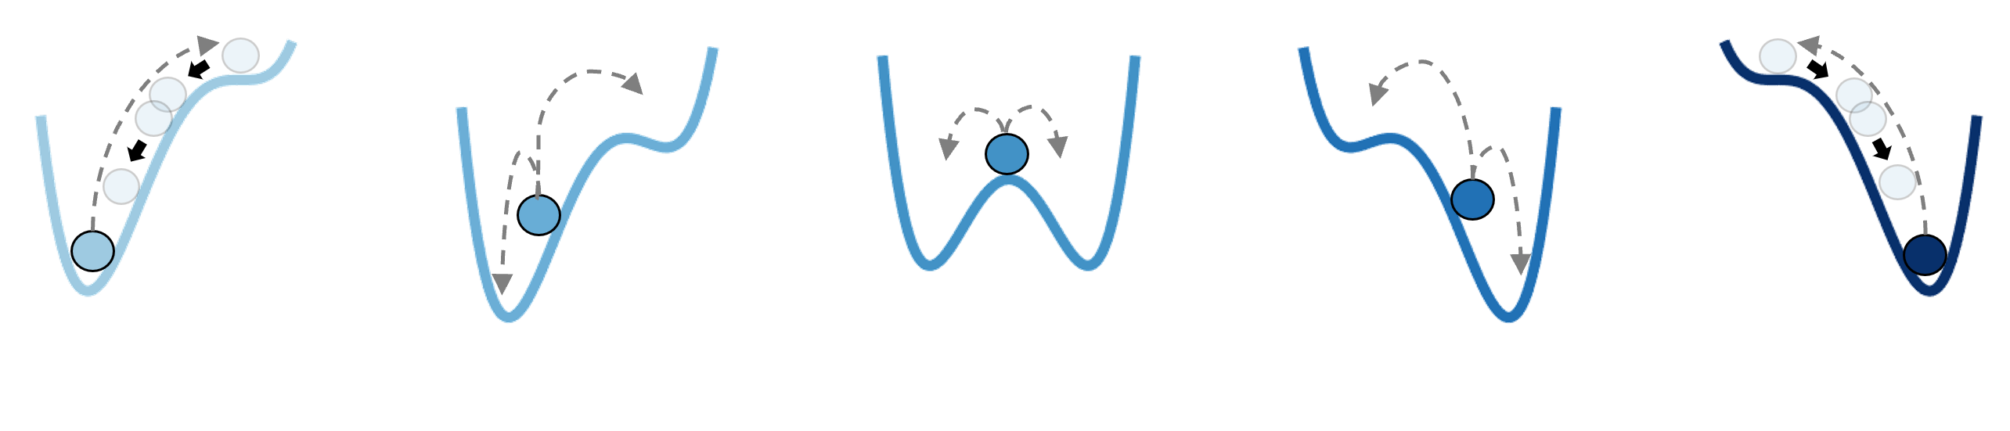


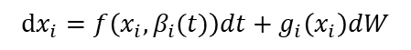
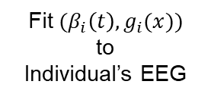

Fig. 1 (Overview)
EEG bistable dynamics during sleep-onset period
“Sleep”
$$(β_{3}\left(t\right),g_{3}(x))$$
Individual variability
“Wake”
$$(β_{2}\left(t\right),g_{2}(x))$$
Frequency [Hz]
Fit $(β_{i}\left(t\right),g_{i}(x))$
to
Individual’s EEG
$$(β_{1}\left(t\right),g_{1}(x))$$
Time
noise
…
…
$$dx_{i}=f\left(x_{i},β_{i}(t)\right)dt+g_{i}\left(x_{i}\right)dW$$
Slow tilt of landscape
(sleep drive)
Stochasticity
stable wake
Increasing sleep drive
stable sleep

Slide 2
Fig. 2 (Embedding Extraction)
SVD
SVD

Slide 3
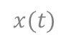
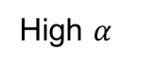
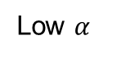
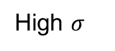
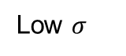

Fig. 3 (Synthesized Time-frequency plot)
Low $σ$
Larger noise
High $σ$
Low $α$
Steeper slope
High $α$
$$x(t)$$
$$β(t)$$
Frequency [Hz]
Time [s]

Slide 4
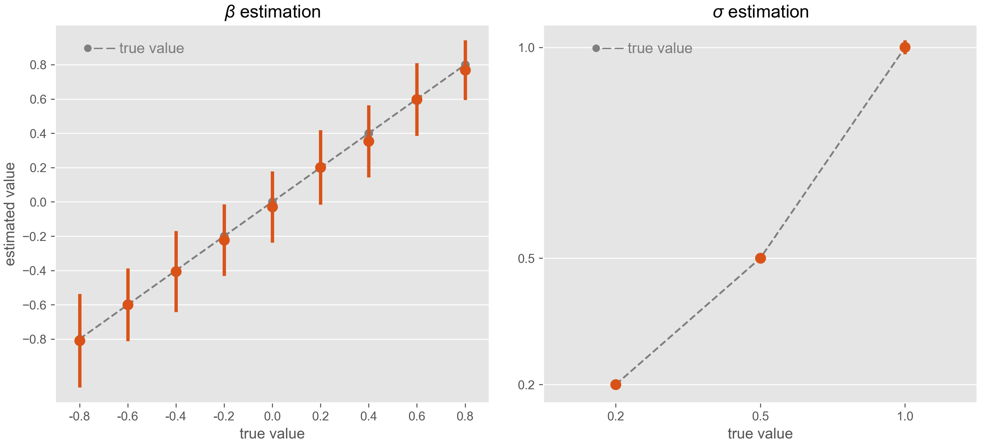
Fig. 4 (Parameter estimation: fixed-landscape)

Slide 5
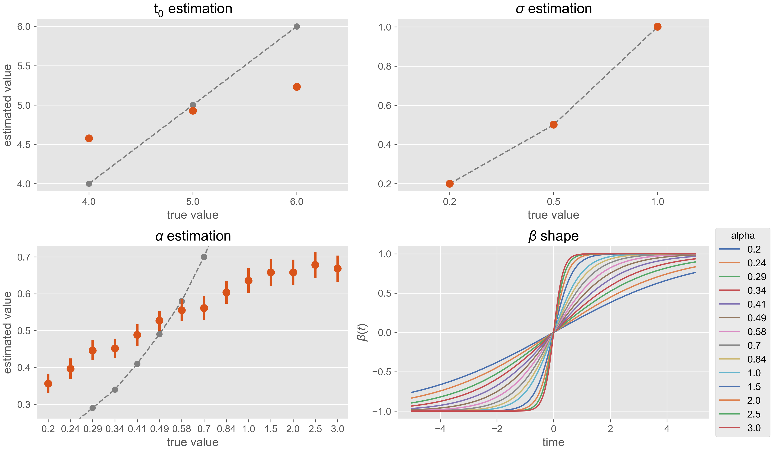
Fig. 5 (Parameter estimation: time-varying landscape)
true value
true value
a)
b)
true value
c)
d)

Slide 6
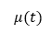
Fig. 6 (Validation in real data)
a)
e)
b)
f)
c)
g)
e)
h)
10%-90% band
$$μ(t)$$

Slide 7
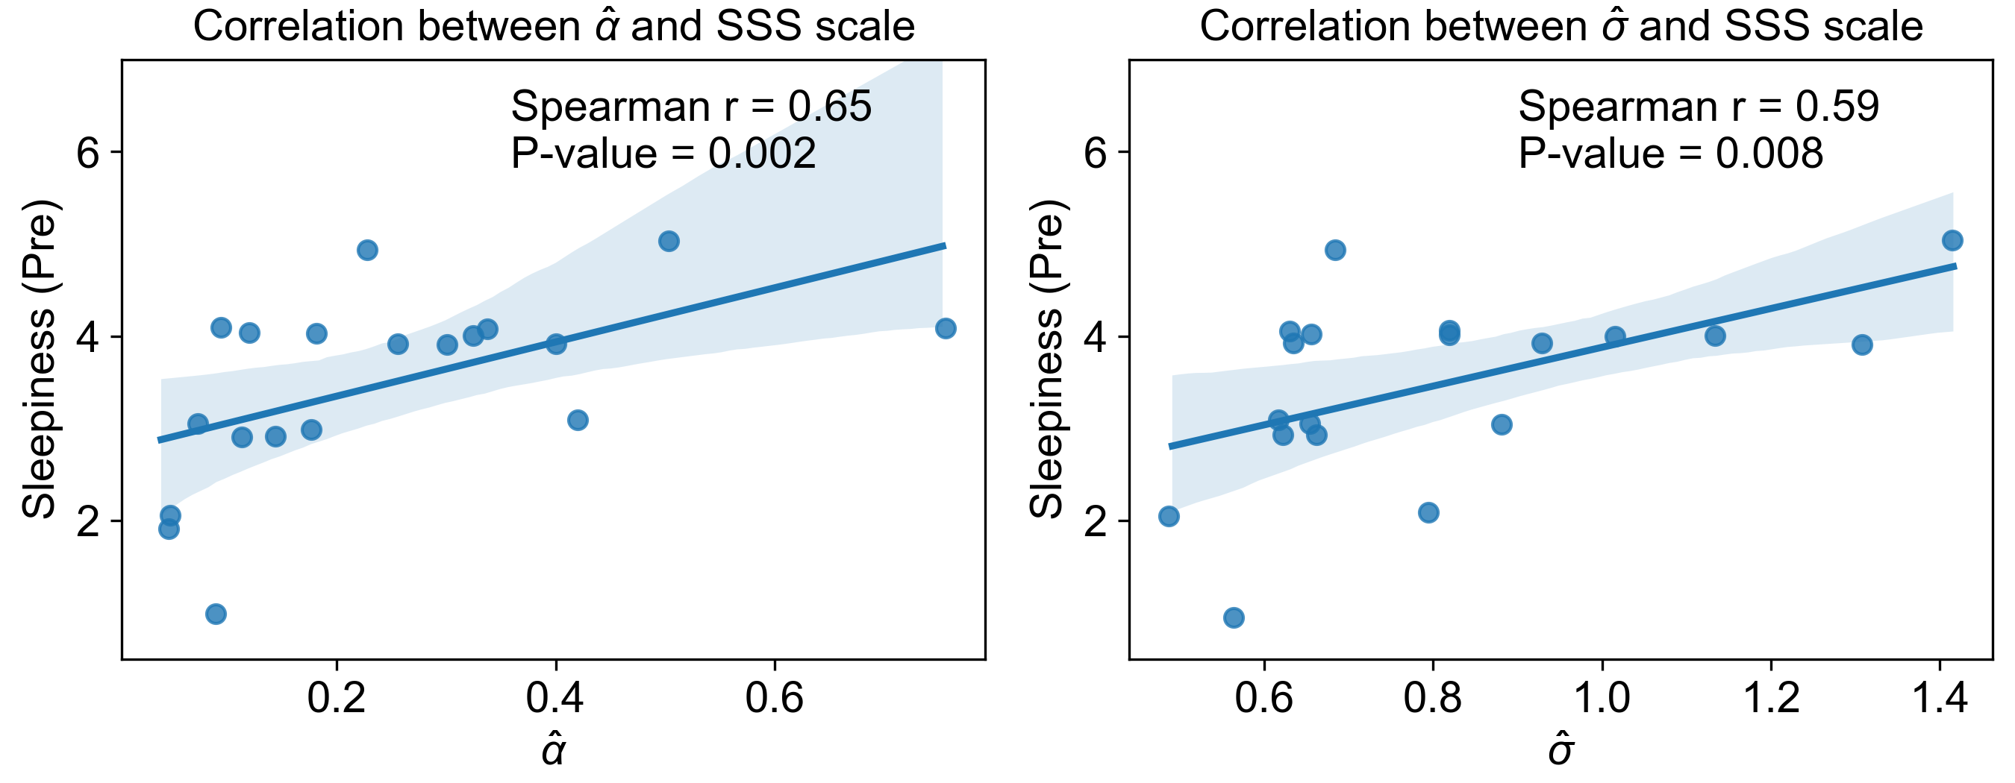
Fig. 7 (Exploratory correlation analysis)
a)
b)

Slide 8
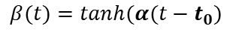
Fig. 8 (Model structure)
$$dx_{t}= =−\left(x_{t}−1\right)\left(x_{t}−β\left(t\right)\right)\left(x_{t}+1\right)+σdW_{t}$$
a)
$$β(t)=tanh⁡(α(t−t_{0})$$
b)
noise
Sleep
c)
Wake
time

